Slide 1
Mobile Sales Dashboard Summary
Analyzing Brands, Regions & Monthly Trends
Power BI
-Somya Sinha

Slide 2
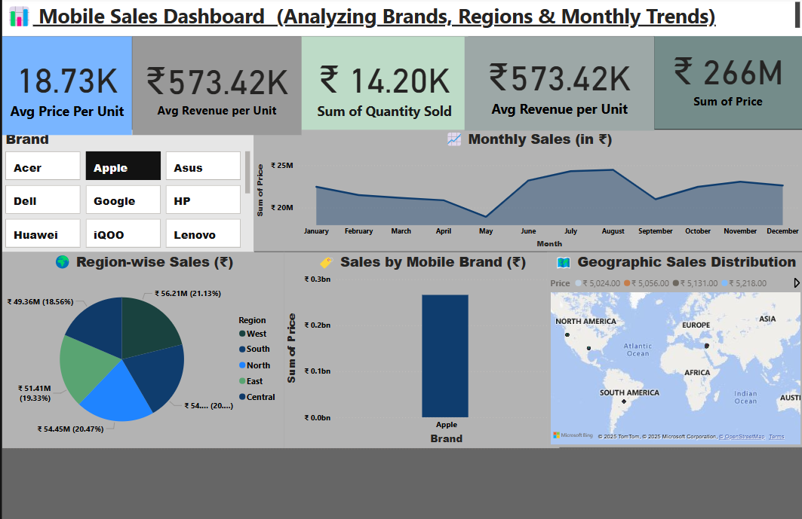

Slide 3
Avg Price Per Unit(Card1)
Formula: [Price] / [Quantity Sold]
Insight: Average price per mobile unit is ₹18.34K, indicating premium product focus.

Slide 4
Avg Revenue per Unit(Card 2)
Formula: [Total Revenue] / [Quantity Sold]
Insight: Each unit generates approx ₹565.79K in revenue, hinting high-value products or bundled deals.

Slide 5
Sum of Quantity Sold(Card 3)
Formula: SUM([Quantity Sold])
Insight: Total of 13.60K units sold shows a healthy volume across brands.

Slide 6
Total Revenue(Card 4)
Formula: SUM([Price])
Insight: Total revenue of ₹249M reflects strong sales performance across regions.

Slide 7
Brand Slicer
Function: Allows users to filter dashboard visuals by selected mobile brands.
Insight: Enhances interactivity and lets stakeholders focus on brand-specific performance.

Slide 8
Monthly Sales Trend(Chart 1)
Chart Type: Line Chart
Metric: Sum of Price by Month
Insight: Seasonal peaks observed around April and June. Sales remain relatively stable post-July.

Slide 9
Region-wise Sales (₹)(Chart 2)
Chart Type: Pie Chart
Metric: Revenue distribution by Region
Insight: Central and North regions contribute the most (~21.16% each), suggesting strong market presence.

Slide 10
Sales by Mobile Brand (Chart 3)
Chart Type: Bar Chart
Metric: Sum of Price by Brand
Insight: HP leads in total sales value among all brands shown.

Slide 11
Geographic Sales Distribution
Chart Type: Map Visualization
Metric: Price across customer locations
Insight: Sales spread across multiple continents indicates a global customer base.

Slide 12
Dashboard Summary
The mobile sales dashboard provides a holistic view of brand performance, regional trends, and monthly revenue insights.
It empowers stakeholders to:
- Identify top-performing regions and brands
- Monitor sales trends over time
- Make informed pricing and inventory decisions
Interactive slicers and dynamic KPIs enhance data exploration and decision-making.

